Slide 1
Thesis Idea

Slide 2
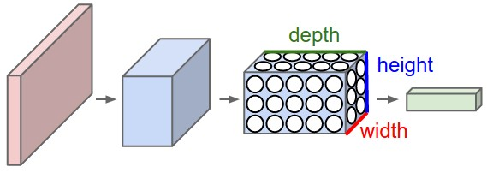
Train a Convolutional neural network…

Slide 3
… but just keep the convolutional features.
Random Forest
Logistic Model Tree
GP classifier (?)
GradientBoosting
XGBoost
Linear Regression
Neural Network
...
Pretrained Model

Slide 4
New datasets with convolutional features are created through convolutional neural networks
Input Datasets
Convolutional Feature Detection
Classification datasets
Convolutional neural network 1
dataset 1
CIFAR-10
Convolutional neural network 2
dataset 2
Convolutional neural network 3
dataset 3
Convolutional neural network 1
dataset 1
CIFAR-100
Convolutional neural network 2
dataset 2
Convolutional neural network 3
dataset 3
Convolutional neural network 1
dataset 1
MNIST
Convolutional neural network 2
dataset 2
Convolutional neural network 3
dataset 3
Convolutional neural network 1
dataset 1
…
Convolutional neural network 2
dataset 2
Convolutional neural network 3
dataset 3

Slide 5
Why do this?
Can model performance be improved by using different classification algorithms on image features?
Does this hold for specific properties? (e.g. few input samples)
Does this apply to on-line systems? (e.g. retraining of the whole model is not efficient but we want to increase accuracy)
Look at indendent variables →

Slide 6
Subsequent Questions
Can we apply backpropagation and use other classification algorithm instead of neural network?

